Slide 1
Advanced higher Graphic communication
Built Environment – Planning Drawings

Slide 2
Learning intentions & success criteria
Learning Intentions
Gain an understanding of the different planning drawings produced by the creators.
Success Criteria
Identify, describe and explain the different planning drawings and their purpose.

Slide 3
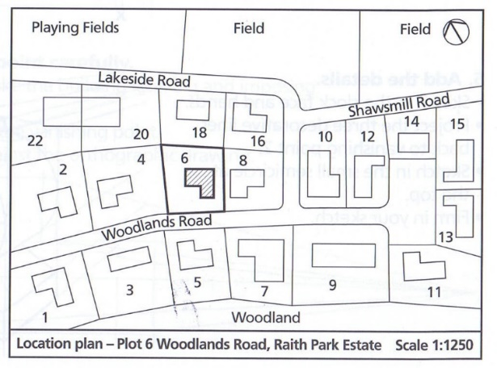
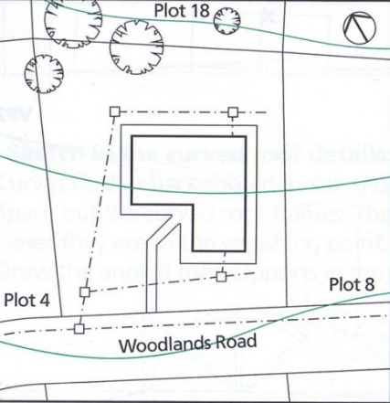
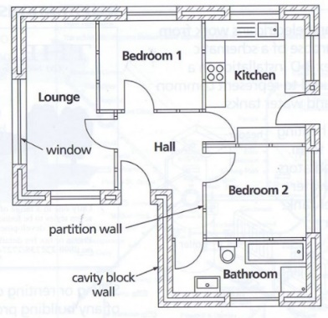
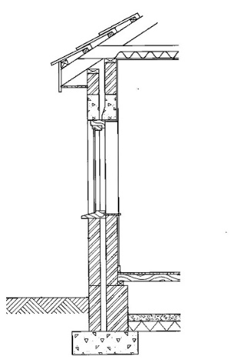
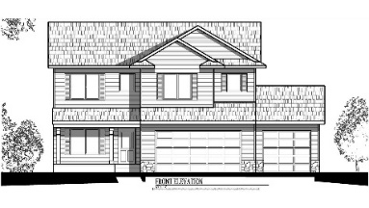
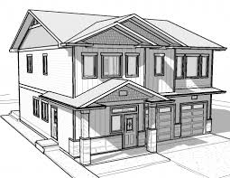
Building drawings
Location Plans (1:2500, 1:1250)
Show the surrounding area and information such as other buildings, roads, landmarks, North symbol, trees).
Site Plans (1:500)
Show immediate site information such as pathways, drainage, trees, roof plan)
Floor Plans (1:100, 1:50)
Show internal information such as layout, doors, windows, fixings and fittings, furniture, electrics, plumbing)
Sections (1:500, 1:100, 1:50)
Show the detail of the structure and multiple levels internally at once.
Elevations (1:500, 1:100, 1:50)
These show features on the sides such as windows, cladding, doors.
3D Views
Represent the building in a way that is easy to understand. Allows walkthroughs and exploration by the clients.

Slide 4
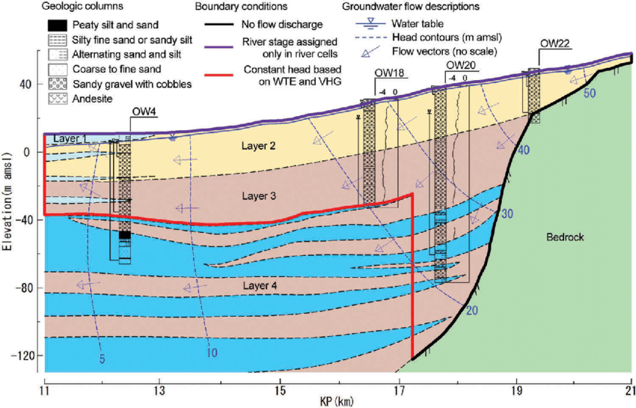
Underground survey
An underground survey is important to carry out for any new building or structure.
It is important to know what you are building on top of, as unknown circumstances could lead to failings in the building in the future.
Information gathered can include:
Previous land use
Land composition (what the exact soils, rock etc. make up the subsurface)
Depth of substrate (down to the layer which will be supporting the foundations)

Slide 5
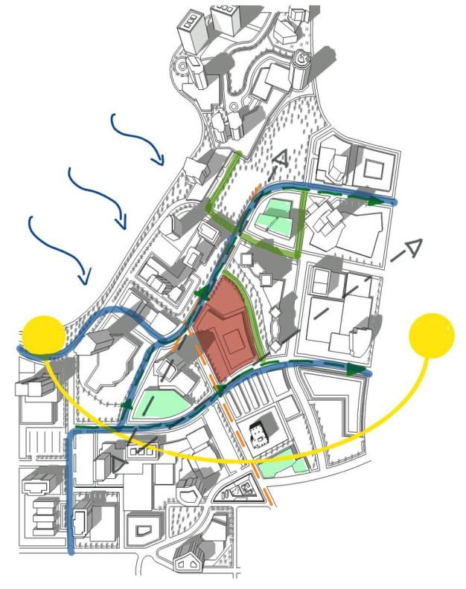
Feature survey
Feature surveys include superficial elements, such as:
Hard landscaping (paving and seating)
Trees, shrubs and bushes
Water features such as ponds
Natural features including contours and layout of the land
Lighting features
Historical features
Ground levels
Fences
Existing structures (buildings, statues, monuments etc).

Slide 6
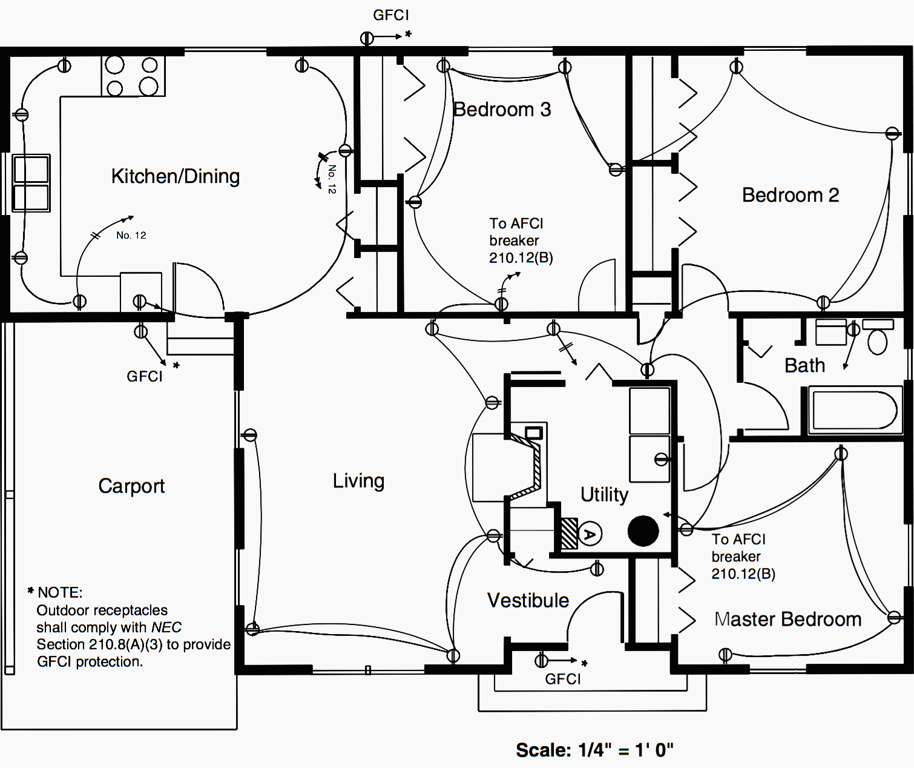
Electrical drawings
Produced by Electrical Draughtsman/ CAD Operators, electrical drawings are schematics which contain information about the electrical and wiring needs for a given project.

Slide 7
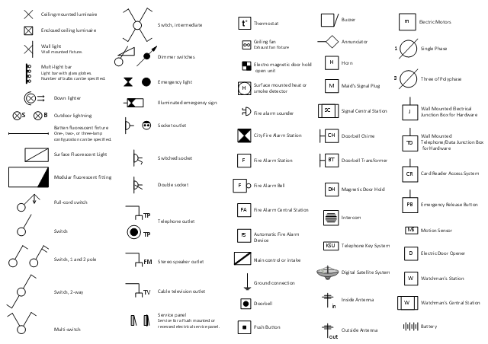
Electrical drawings
These may include power, lighting, data and telephony wiring; the location of outlets, switches, connections, breakers and distribution boards; other “hardwired” electrical systems and devices (fans, alarm systems, public address systems etc.).

Slide 8
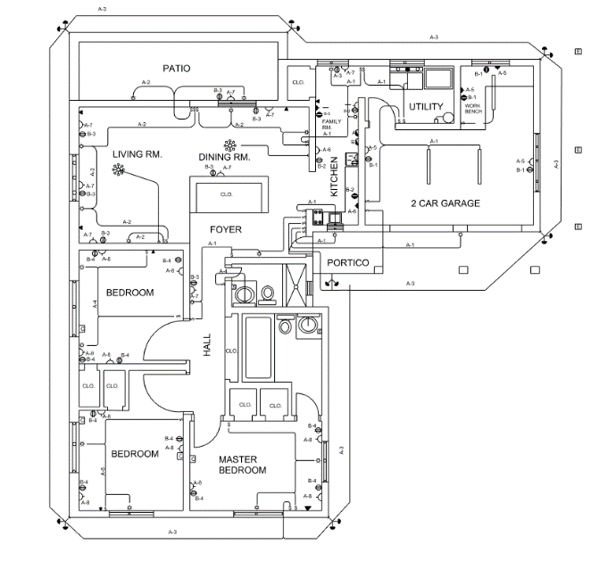
Electrical drawings
Drawings may be in the form of a floor plan showing location of features (outlets, devices, switches etc) and the general connections between, or wiring diagrams showing specific wiring and interconnection information.
Drawings use a standard library of symbols to ensure understanding.

Slide 9
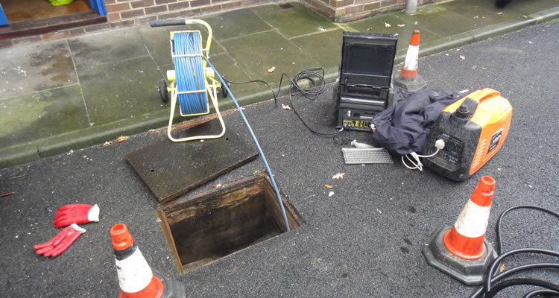
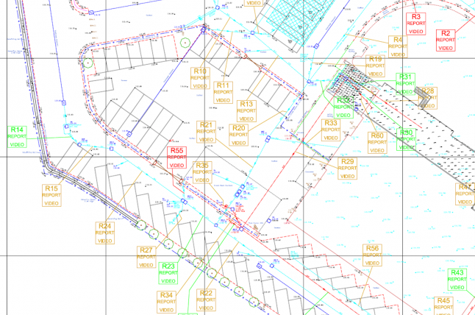
Drainage surveys
Drainage surveys deal with locating and cataloguing the existence, location and condition of drainage systems and their components.
They can comprise of tables containing data on the locations and conditions of components, drawings and diagrams of the systems, and CCTV footage/images showing internal details of pipe networks and components. These will be prepared by drainage surveyors/ engineers and CAD Technicians/ Draughtsmen.
Drainage surveys are useful for planning and creating new engineering works, modifying existing ones, or for maintenance of drainage systems themselves. As such they may be used by a range of people including civil engineers, site engineers, architects, planners and drainage engineers.

Slide 10
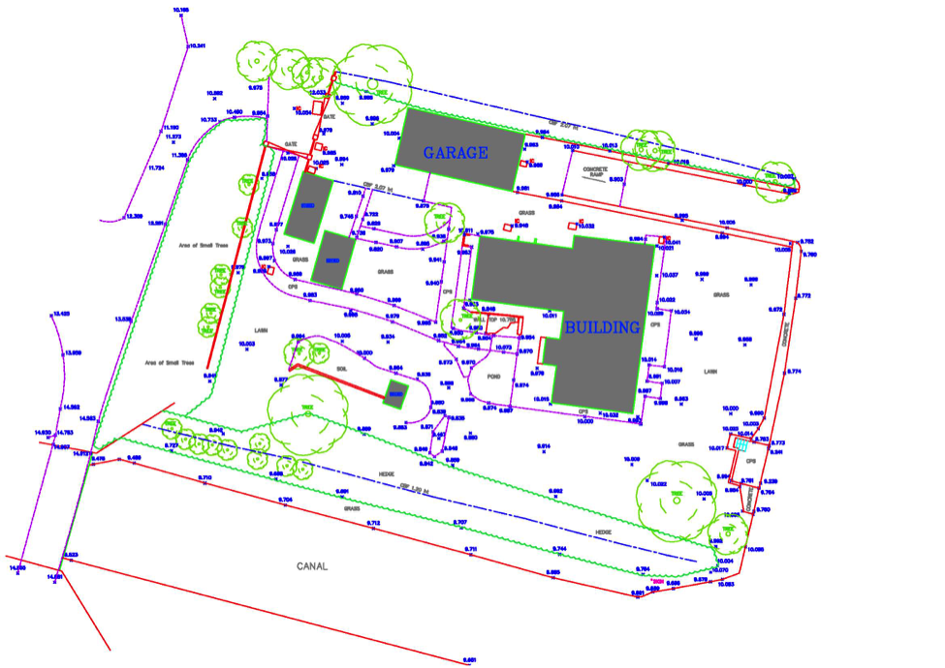
Topographical survey
Topographical survey is used to create maps containing details of the land and the features on it.
These include natural features such as tree, rocks and waterways, and man made ones like buildings, walls, fences, telecom poles etc.

Slide 11
Topographical survey
The survey will also detail the contours of the land. A land surveyor (a specialist profession in it’s own right) will make use of a variety of specialist equipment and GPS to take readings about the shape of the ground and the height and location of objects in and on it.
The information gained form topographical surveys is used in construction for planning and building by architects, engineers and builders but may also be used by cartographers when preparing and updating maps.

